Slide 1
Support Vector Machines

Slide 2
Support Vector Machines – In a nutshell
New method for the classification of both linear and nonlinear data.
It uses a nonlinear mapping to transform the original training data into a higher dimension.
Within this new dimension, it searches for the linear optimal separating hyperplane (that is, a “decision boundary” separating the tuples of one class from another).
With an appropriate nonlinear mapping to a sufficiently high dimension, data from two classes can always be separated by a hyperplane.
The SVM finds this hyperplane using support vectors (“essential” training tuples) and margins (defined by the support vectors).

Slide 3
Support Vector Machines
The first paper =>presented in 1992 by Vladimir Vapnik and colleagues Bernhard Boser and Isabelle Guyon.
The training time of even the fastest SVMs can be extremely slow.
But they are highly accurate, owing to their ability to model complex nonlinear decision boundaries.
They are much less prone to overfitting than other methods.
SVMs can be used for prediction as well as classification.
Applications= >handwritten digit recognition, object recognition, and speaker identification, as well as benchmark time-series prediction tests.

Slide 4
The Case When the Data Are Linearly Separable
Let the data set D be given as (X₁, y1), (X₂, y₂), : : : , (X_{|D|} , y_{|D|} ),where X_{i} is the set of training tuples with associated class labels, yi.
Each y_{i} can take one of two values, either+1 or -1 (i.e., y_{i} ∈ { +1,-1} ), corresponding to the classes buys computer = yes and buys computer = no, respectively.
To aid in visualization, consider two input attributes, A1 and A2,

Slide 5
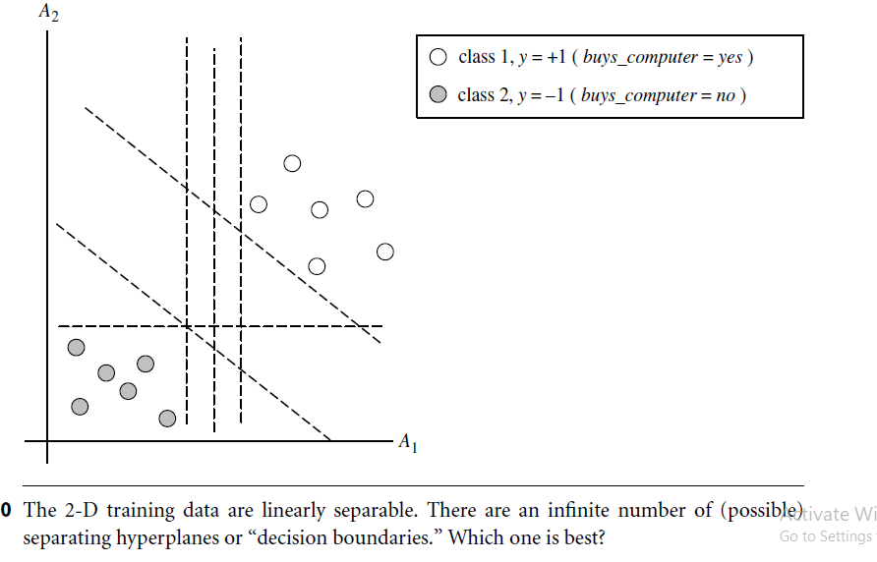

Slide 6
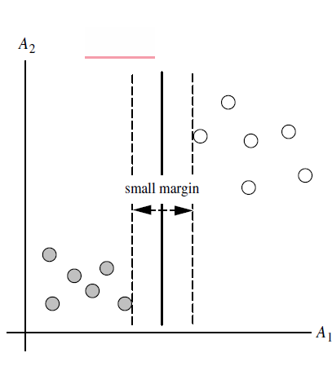
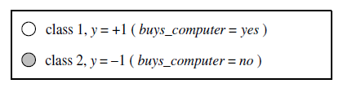
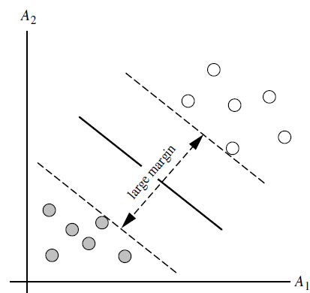
There are an infinite number of separating lines that could be drawn.
We need to find the “best” one, that is, one that will have the minimum classification error on previously unseen tuples=>identify the best hyperplane.
Start by searching for the maximum marginal hyperplane.

Slide 7
The associated margin gives the largest separation between classes.
When dealing with the MMH, this distance is the shortest distance from the MMH to the closest training tuple of either class.
A separating hyperplane can be written as
W.X + b = 0
Where W is a weight vector, namely,W = {w1, w2, . . . , wn};
n is the number of attributes;
b is a scalar, often referred to as a bias.

Slide 8
Consider two input attributes, A1 and A2.
Training tuples are 2-D, e.g., X = (x₁, x₂), where x₁ and x₂ are the values of attributes A₁ and A₂, respectively, for X.
If we think of b as an additional weight, w₀, we can rewrite the above separating hyperplane as
w₀ + w₁x₁ + w₂x₂ = 0
Thus, any point that lies above the separating hyperplane satisfies
w₀ + w₁x₁ + w₂x₂ > 0
Similarly, any point that lies below the separating hyperplane satisfies
w₀ + w₁x₁ + w₂x₂ < 0

Slide 9

The weights can be adjusted so that the hyperplanes defining the “sides” of the margin
can be written as
H1 : w₀ + w₁x₁ + w₂x₂ ≥ 1 for y_{i} = +1,
H2 : w₀ + w₁x₁ + w₂x₂ ≤ -1 for y_{i} = -1
i.e; any tuple that falls on or above H1 belongs to class +1, and any tuple that falls on or below H2 belongs to class -1.
Combining the two inequalities of Equations above , we get
y_{i} (w₀ + w₁x₁ + w₂x₂ ) ≥ 1,
Any training tuples that fall on hyperplanes H1 or H2 are called support vectors.
They are equally close to the (separating) MMH.
The most difficult tuples to classify and give the most information regarding classification.

Slide 10



A formulae for the size of the maximal margin.
The distance from the separating hyperplane to any point on H1 is
where ||W|| is the Euclidean norm of W, that is
By definition, this is equal to the distance from any point on H2 to the separating hyperplane.
Therefore, the maximal margin is
Any optimization software package for solving constrained convex quadratic problems can then be used to find the support vectors and MMH.
For larger data, special and more efficient algorithms for training SVMs can be used instead.

Slide 11

Trained support vector machine-> how do I use it to classify test (i.e., new) tuples?”
Based on the Lagrangian formulation, the MMH can be rewritten as the decision boundary.
where y_{i} is the class label of support vector X_{i};
X^{T} is a test tuple;
α_{i} and b₀ are numeric parameters that were determined automatically by the optimization or SVM algorithm and
l is the number of support vectors.

Slide 12
Given a test tuple, X^{T} , and then check to see the sign of the result.
This tells us on which side of the hyperplane the test tuple falls.
If the sign is positive, then X^{T} falls on or above the MMH, and so the SVM predicts that X^{T} belongs to class +1 (representing buys computer = yes).
If the sign is negative, then X^{T} falls on or below the MMH and the class prediction is -1 (representing buys computer = no).

Slide 13
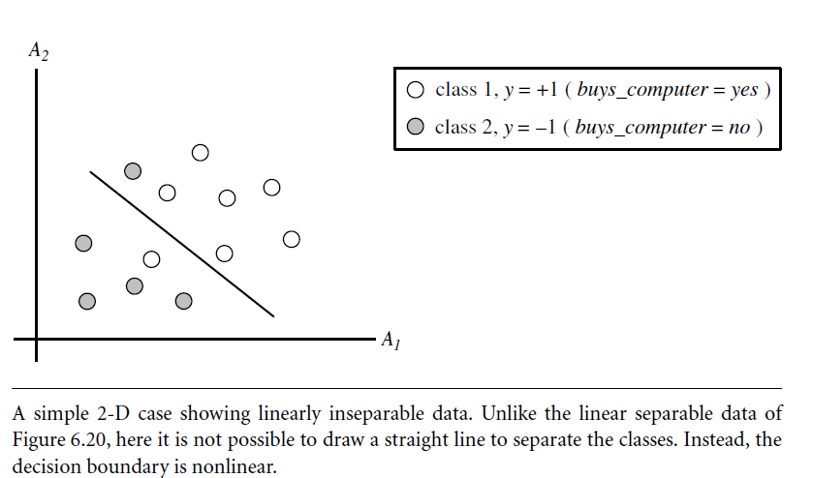
The Case When the Data Are Linearly Inseparable
i.e; no straight line can be found that would separate the classes.
SVMs can be extended to create nonlinear SVMs for the classification of linearly inseparable data.
Capable of finding nonlinear decision boundaries (i.e., nonlinear hypersurfaces) in input space.

Slide 14
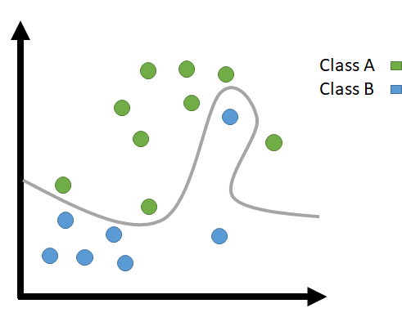
The Case When the Data Are Linearly Inseparable
There are two main steps.
Step 1: Transform the original input data into a higher dimensional space using a nonlinear mapping.
Step 2: Search for a linear separating hyperplane in the new space.
Leads to quadratic optimization problem that can be solved using the linear SVM formulation.
The maximal marginal hyperplane found in the new space corresponds to a nonlinear separating hypersurface in the original space.

Slide 15
Eg: Nonlinear transformation of original input data into a higher dimensional space.
A 3D input vector X = (x₁, x₂, x₃) is mapped into a 6D space, Z, using the mappings Φ (X) = x₁, Φ(X) = x₂, Φ(X) = x₃, Φ(X) = (x₁)², Φ(X) =x₁x₂, and Φ(X) = x₁x₃.
A decision hyperplane in the new space is d(Z) = WZ + b, where W and Z are vectors.
This is linear.
Solve for W and b and then substitute back so that the linear decision hyperplane in the new (Z) space corresponds to a nonlinear second-order polynomial in the original 3-D input space,
d(Z) = w₁x₁ + w₂x₂ + w₃x₃ + w₄(x₁)² + w₅x₁x₂ + w₆x₁x₃ + b
= w₁z₁+ w₂z₂ + w₃z₃ + w₄z₄ + w₅z₅ + w₆z₆ + b

Slide 16
Issues…
How do we choose the nonlinear mapping to a higher dimensional space?
The computation involved is costly.
Given the test tuple, we have to compute its dot product with every one of the support vectors.
In training, we have to compute a similar dot product several times in order to find the MMH. This is expensive.
Hence, the dot product computation required is very heavy and costly.

Slide 17
Solution
Computing the dot product (Φ(X_{i}). Φ(X_{j})) on the transformed data tuples is mathematically equivalent to applying a kernel function, K(X_{i},X_{j}), to the original input data.
K(X_{i},X_{j}) = Φ(X_{i}). Φ(X_{j}))
Adv: all calculations are made in the original input space, which is of potentially much lower dimensionality.

Slide 18
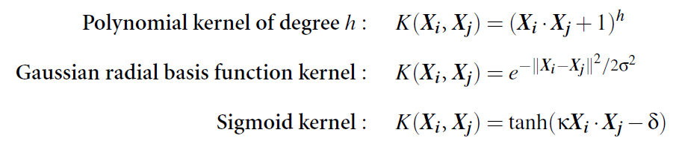
What are some of the kernel functions that could be used?
Each of these results in a different nonlinear classifier in (the original) input space.
An SVM with a Gaussian radial basis function (RBF) gives the same decision hyperplane as a type of neural network known as a radial basis function (RBF) network.
An SVM with a sigmoid kernel is equivalent to a simple two-layer neural network known as a multilayer perceptron.

Slide 19
How to choose kernel function?
No golden rules for determining which kernel will result in the most accurate SVM.
In practice, the kernel chosen does not generally make a large difference in resulting accuracy.
SVM training always finds a global solution.
SVMs can be used for binary and multiclass cases.
A simple and effective approach=> given m classes, trains m classifiers, one for each class.
SVMs can also be designed for linear and nonlinear regression.

Slide 20
Major Research in SVMs
To improve the speed in training and testing so that SVMs may become a more feasible option for very large data sets (e.g., of millionsof support vectors).
Determining the best kernel for a given data set.
Finding more efficient methods for the multiclass case.

